Slide 1
Data Types, Variables and Arrays

Slide 2
Agenda
Data types
Primitive data types
Reference data types
Scope and lifetime of variables
Type conversion
Arrays

Slide 3
Data Types in Java
Java is a strongly typed language
Every variable, expression has a type and every type is strictly defined.
Type compatibility is checked.
Impossible to typecast incompatible types.
Data types may be:
Primitive data types
Reference data types

Slide 4
Primitive Data Types in Java
Integer Data Types
byte | (1 byte)
short | (2 bytes)
int | (4 bytes)
long | (8 bytes)
Floating Data Types
float | (4 bytes)
double | (8 bytes)
Character Data Types
char | (2 bytes)
Logical/Boolean Data Types
boolean | (1 bit) (true/false)
All numeric data types are signed
The size of data types remain same on all platforms
Notes:
Purity Tip: In other programming languages, the format and the size of primitive data types can depend on the system on which the program is running.
In contrast, the Java programming language specifies the size and the format of its primitive data types. Hence, you don't have to worry about system dependencies.
Without initializing if you use a variable in Java it is an error, it doesn’t take garbage values.
In C boolean is non zero value but in Java it is true or false.
All reference variables are created by using new.
Implicit type casting will not occur in Java if there is data loss.
Int i;
Double d;
i=(int) d;
D=i; // implicit type casting will not occur if there is loss of data.
For floating point constant append f i.e 2.33f
For long append L i.e 2.45678L
Java Strings are not null-terminated as they are in some other computer languages.
One portion of Java conversion rules is called integral promotion.
In Java whenever a char, a byte or a short is used in an expression, its value is automatically elevated to int during the evaluation of that expression. This is only during the evaluation of expression.

Slide 5
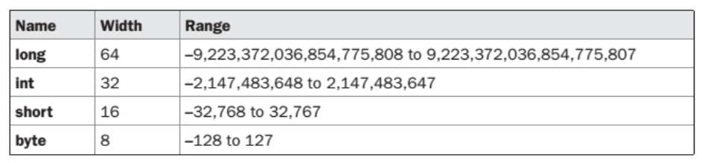
Integer
All of these are signed, positive and negative values.
Java does not support unsigned, positive-only integers.
Because of Java’s portability requirement, all data types have a strictly defined range for example: int is always 32 bits.

Slide 6
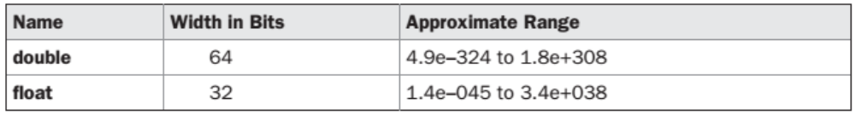
Floating-Point
Also known as real numbers.
Used for evaluating expressions that require fractional precision.
There are two kinds of floating-point types
float and double

Slide 7
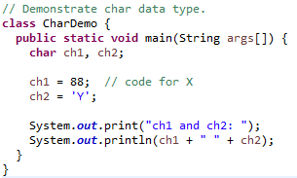
Characters
In C/C++, char is 8 bits wide.
Java uses Unicode to represent characters.
Unicode defines a fully international character set that can represent all of the characters found in all human languages.
Java char is a 16-bit type.
No negative char.
The range is 0 to
65536.

Slide 8
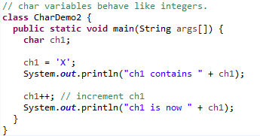
Characters and Integers

Slide 9
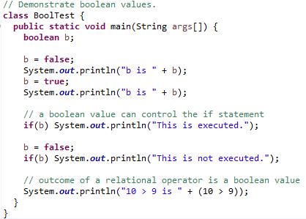
Booleans
Two possible values:
true or false
This is the type returned by all relational operators.
Used by conditional expressions.

Slide 10
Variables
A named storage location in the computer’s memory that stores a value of a particular type for use by program.
Declaration:
type identifier [=value] [, identifier=[value] … ];
Example of variable declaration:

Slide 11
Variables (Contd…)
Using primitive data types is similar to other languages
int count;
int max=100;
Variables can be declared anywhere in the program
for (int count=0; count < max; count++) {
int z = count * 10;
}
In Java, if a local variable is used without initializing it, the compiler will show an error
BEST PRACTICE
Declare a variable in program only when required
Do not declare variables upfront like in C

Slide 12
Give this a Try…
What will be the output of the following code snippet when you try to compile and run it?
class Sample
{
public static void main (String args[])
{
int count;
System.out.println(count);
}
}
Notes:
Error : variable count might not have been initialized : i.e Java doesnot initialize it with garbage values it gives error.

Slide 13
Reference Data Types
Hold the reference of dynamically created objects which are in the heap
Can hold three kinds of values:
Class type: Points to an object / class instance
Interface type: Points to an object, which is implementing the corresponding interface
Array type: Points to an array instance or “null”
Difference between Primitive & Reference data types:
Primitive data types hold values themselves
Reference data types hold reference to objects, i.e. they are not objects, but reference to objects

Slide 14
Reference Data Types (Contd…)
Objects & Arrays are accessed using reference variables in Java
A reference variable is similar to a pointer (stores memory address of an object)
Java does not support the explicit use of addresses like other languages
Java does not allow pointer manipulation or pointer arithmetic
Memory Representation:
A variable of reference type contains a reference to (an address of) an object or an array as shown in fig.
int primitive = 5;
String reference = “Hello” ;
primitive
5
reference
Hello

Slide 15
Difference between pointers and references
Printing a pointer will print the address stored in it whereas Printing a reference will NOT print the address of the object referred by it.
A reference is automatically de-referenced to give the data referred by it and no special operator is required for this.

Slide 16
Reference Data Types (Contd…)
A reference type cannot be cast to primitive type
But Primitive to Reference type you can convert by using Wrapper classes.
A reference type can be assigned ‘null’ to show that it is not referring to any object
Arrays, classes, and interfaces are reference types. The value of a reference type variable, in contrast to that of a primitive type, is a reference to (an address of) the value or set of values represented by the variable.
A reference is called a pointer, or a memory address in other languages. The Java programming language does not support the explicit use of addresses like other languages do; you need to use the variable's name instead.
All user defined objects , built in objects like arrays are Reference types.
Reference variables always take space on Heap while primitive variables are stored in stack.

Slide 17
Scope and Lifetime Variables
A block defines the scope of a variable
Java defines two types of scope; Class scope and method scope
Class scope has unique properties and attributes that do not apply to method scope
Variables declared inside a scope are not visible (that is, accessible) to code that is defined outside that scope
Variables are created when their scope is entered, and destroyed when their scope is left
Scopes can be nested
Java does not permit using the same name again if a variable is declared in outer scope

Slide 18
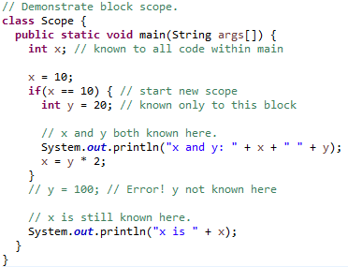
Scope of variables

Slide 19
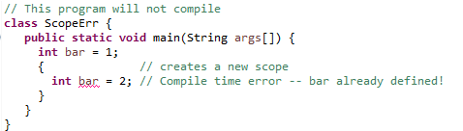
Scope of variables

Slide 20
Scope of Variables
Instance Variables (also called Member Variables)
Declared inside a class
Outside any method or constructor
Belong to the object
Stored in heap area with the object to which they belong to
Lifetime depends on the lifetime of object
Local Variables (also called Stack Variables)
Declared inside a method
Method parameters are also local variables
Stored in the program stack along with method calls and live until the call ends

Slide 21
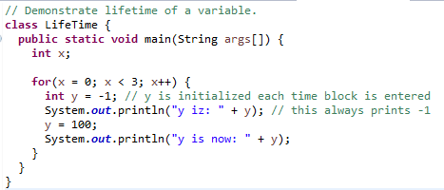
Lifetime of variables
The lifetime of a variable refers to how long the variable exists before it is destroyed.
Destroying variables refers to deallocating the memory that was allotted to the variables when declaring it.

Slide 22
Member & Automatic variables
Java supports variables of two different lifetimes:
A member variable is the one which is created when an instance or an object is created, and is accessible from any method in the class.
An automatic variable is similar to the local variable. It is alive as long as the control is within the function. The programmer must initialize a local variable before it is used.
Member Variables
Defined in a class, outside methods or constructors.
They are alive as long as the object exists.
Automatic Variables or Local Variables
These are declared within methods or blocks
They are alive as long as the control is within the function.
Variables passed as parameters also fall in this category

Slide 23
Scope of Variables (Contd…)
If we don’t initialize instance variables explicitly, they are awarded predictable default initial values, based only on the type of the variable
Local variables are not initialized implicitly
Type | Default Value
boolean | false
byte | (byte) 0
short | (short) 0
int | 0
long | 0L
char | \u0000
float | 0.0f
double | 0.0d
object reference | null

Slide 24
Scope of Variables (Contd…)
class Student{
int rollNo;
String name;
public void display (int z){
int x=z+10;
}
}
rollNo and name are instance variables to be stored in the heap
z and x are local variables to be stored in the stack

Slide 25
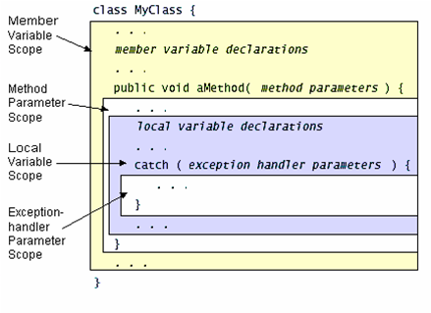
Scope of Variables (Contd…)

Slide 26
Lifetime of Objects
obj1
1
Student obj1 = new student();
Student obj2 = new student();
Both Student objects now live on the heap
→ References : 2
→ Objects : 2
Student obj3 = obj2;
→ References : 3
→ Objects : 2
2
Heap
obj2
obj1
1
obj3
2
Heap
obj2

Slide 27
Lifetime of Objects
obj1
obj3 = obj1;
→ References : 3
→ Objects : 2
obj2 = null;
→ Active References : 2
→ Null References : 1
→ Reachable Objects : 1
→ Abandoned objects : 1
1
obj3
2
Heap
obj2
obj1
1
obj3
2
Heap
obj2
Null Reference
This object can be garbage collected

Slide 28
Type Casting and Promotion
Automatic type conversion (widening conversion) will take place if the following two conditions are met:
The two types are compatible.
The destination type is larger than the source type.
No automatic conversions from the numeric types to char or Boolean
Explicit type casting (narrowing conversion)
When a floating-point value is assigned to an integer type, the fractional component is lost. (truncation)
If the size of the whole number component is too large to fit into the target integer type, then that value will be reduced modulo the target type’s range.
(target-type) value

Slide 29
Typecasting Primitive Data Types
Automatic type changing is known as Implicit Conversion
Widening conversion
A variable of smaller capacity can be assigned to another variable of bigger capacity
int i = 10;
double d;
d = i;
Whenever a larger type is converted to a smaller type, we have to explicitly specify the type cast operator
double d = 10;
int i;
i = (int) d;
Narrowing conversion
This prevents accidental loss of data
Type cast operator
Notes:
Type Conversion and Casting
A variable of one type can receive the value of another type, provided the data type of the two variables are same or if the data type of the variable receiving data is wider then the data type of the variable from which its receiving data.
In some cases, the system implicitly changes the type of an variable without your explicitly performing a cast. You can explicitly change the type of a value by casting. The process of assigning a value of variable of one type to a variable of another type is called casting. Automatic type changing is known as Implicit Conversion. If the data types of the two variables involved in the conversion are compatible, then Java does the conversion automatically. If the data types are not same, then a cast must be done explicitly.
E.g.:
An int value can be assigned to a long variable but there is no conversion defined from float to byte.
CastingExample.java
// TYPE CASTING
class CastingExample
{ public static void main(String args[])
{ byte x;
int a=270;
double b =128.128;
System.out.println("\n int converted to byte");
x=(byte) a;
System.out.println("a and x "+ a +" "+x);
System.out.println("\n double converted to int");
a=(int) b;
System.out.println("b and a "+ b +" "+a);
System.out.println("\n double converted to byte");
x=(byte) b;
System.out.println("b and x "+b +" "+x);
}
}

Slide 30
Type casting and conversion
// Demonstrate casts.
class Conversion {
public static void main(String args[]) {
byte b;
int i = 257;
double d = 323.142;
float f = 128.78f;
System.out.println("\nConversion of int to byte.");
b = (byte) i;
System.out.println("i and b " + i + " " + b); // 257 1
System.out.println("\nConversion of double to int.");
i = (int) d;
System.out.println("d and i " + d + " " + i); // 323.142 323
System.out.println("\nConversion of double to byte.");
b = (byte) d;
System.out.println("d and b " + d + " " + b); // 323.142 67
System.out.println("\nConversion of float to byte.");
b = (byte) f;
System.out.println(“f and b " + f + " " + b); // 128.78 -128
}
}

Slide 31
Automatic type promotion
Here a * b exceeds the byte range.
Java automatically promotes each byte, short, or char operand to int when evaluating an expression.
byte a = 40;
byte b = 50;
byte c = 100;
int d = a * b / c;
byte b = 50;
b = b * 2; // Error! Cannot assign an int to a byte!
byte b = 50;
b = (byte)(b * 2);

Slide 32
Automatic type promotion
First, all byte, short, and char values are promoted to int, as just described. Then, if one operand is a long, the whole expression is promoted to long. If one operand is a float, the entire expression is promoted to float. If any of the operands is double, the result is double.
class Promote {
public static void main(String args[]) {
byte b = 42;
char c = 'a';
short s = 1024;
int i = 50000;
float f = 5.67f;
double d = .1234;
double result = (f * b) + (i / c) - (d * s);
System.out.println((f * b) + " + " + (i / c) + " - " + (d * s));
System.out.println("result = " + result); }
}

Slide 33
Type Conversion
byte → short → int → long (implicitly)
byte ← short ← int ← long (explicitly)
float → double (implicit)
float ← double (explicit)
int ← float, double (explicit)
long ← float, double (explicit)
char ← byte, short, int, long, float, double (explicit)
boolean (cannot be casted)

Slide 34

Arrays in Java
A data structure which defines an ordered collection of a fixed number of homogeneous data elements
Size is fixed and cannot increase to accommodate more elements
Arrays in Java are objects and can be of primitive data types or reference variable type
All elements in the array must be of the same data type
An array holding 5 int elements
22
33
66
100
72
An array holding 4 rabbit objects
Reference to Rabit Object

Slide 35
Arrays in Java (Contd…)
Reference variables are used in Java to store the references of objects created by the operator new
Any one of the following syntax can be used to create a reference to an int array
The reference x can be used for referring to any int array
int x[];
int [] x;
//Declare a reference to an int array
int [] x;
//Create a new int array and make x refer to it
x = new int[5];

Slide 36
Arrays in Java (Contd…)
The following statement also creates a new int array and assigns its reference to x
In simple terms, references can be seen as names of an array.
An array can be initialized while it is created as follows:
int [] x = new int[5];
int [] x = {1, 2, 3, 4};
char [] c = {‘a’, ‘b’, ‘c’};

Slide 37
Arrays
// Demonstrate a one-dimensional array.
class Array {
public static void main(String args[]) {
int month_days[];
month_days = new int[12];
month_days[0] = 31;
month_days[1] = 28;
month_days[2] = 31;
month_days[3] = 30;
month_days[4] = 31;
month_days[5] = 30;
month_days[6] = 31;
month_days[7] = 31;
month_days[8] = 30;
month_days[9] = 31;
month_days[10] = 30;
month_days[11] = 31;
System.out.println("April has " + month_days[3] + " days.");
}
}

Slide 38
Arrays
// An improved version of the previous program.
class AutoArray {
public static void main(String args[]) {
int month_days[] = { 31, 28, 31, 30, 31, 30, 31, 31, 30, 31, 30, 31 };
System.out.println("April has " + month_days[3] + " days.");
}
}
// Average an array of values.
class Average {
public static void main(String args[]) {
double nums[] = {10.1, 11.2, 12.3, 13.4, 14.5};
double result = 0;
int i;
for(i=0; i<5; i++)
result = result + nums[i];
System.out.println("Average is " + result / 5);
}
}

Slide 39
Length of an Array
Unlike C, Java checks the boundary of an array while accessing an element in it
Programmer not allowed to exceed its boundary
And so, setting a for loop as follows is very common:
for(int i = 0; i < x.length; ++i){
x[i] = 5;
}
This works for any size array
use the .length attribute of an array to control the for loop

Slide 40
Multidimensional Arrays
A Multi-dimensional array is an array of arrays
To declare a multidimensional array, specify each additional index using another set of square brackets
int [][] x;
//x is a reference to an array of int arrays
x = new int[3][4];
//Create 3 new int arrays, each having 4 elements
//x[0] refers to the first int array, x[1] to the second and so on
//x[0][0] is the first element of the first array
//x.length will be 3
//x[0].length, x[1].length and x[2].length will be 4

Slide 41
Multidimensional Arrays
To allocate memory for a multidimensional array, need to only specify the memory for the first (leftmost) dimension.
Allocate the remaining dimensions separately.
int twoD[ ][ ] = new int[4][ ];
twoD[0] = new int[5];
twoD[1] = new int[5];
twoD[2] = new int[5];
twoD[3] = new int[5];

Slide 42
Alternative Array Definition Syntax
type[ ] var-name;
int al[ ] = new int[3];
int[ ] a2 = new int[3];
char twod1[ ][ ] = new char[3][4];
char[ ][ ] twod2 = new char[3][4];
int[ ] nums, nums2, nums3; // create three arrays
int nums[ ], nums2[ ], nums3[ ]; // create three arrays

Slide 43
Command Line Arguments
Information that follows program’s name on the command line when it is executed
This data is passed to the application in the form of String arguments
class Echo {
public static void main (String args[]) {
for (int i = 0; i < args.length; i++) System.out.println(args[i]);
}
}
Try this: Invoke the Echo application as follows
C:\> java Echo Drink Hot Java
Drink
Hot
Java
Notes:
All Java applications contain a static method named main(). This method takes one argument that is an array of String objects.
These objects represent any arguments that may have entered by the user on the command line.
The number of command line arguments is obtained via the expression args.length. This is an int type.
The individual arguments are accessed as args[0], args[1] , args[2] and so forth.
Remember what ever we enter at command line are treated as strings .So if I have to take two numbers from command line and fine their sum then I have to take use of Wrapper Class which converts Reference(String) to primitive types.,

Slide 44
THANK YOU!!
ANY QUESTIONS??

